Slide 1


The Anti-MEV DEX with Flash Arbitrage - deployed on Polygon

Slide 2

01
The Problem
Content
02
Flash Arbitrage
03
Our Demo

Slide 3
1.1 DEX Arbitrage Bot
Block Body - Without Arbitrage
……
DEX Bot purchase 1000 ETH at Uni
……
……
Block Body - With Arbitrage
……
DEX Bot purchase 1000 ETH at Uni
Arbitrage Bot1 send arbitrage transaction
Arbitrage Bot2 send arbitrage transaction
……

Slide 4
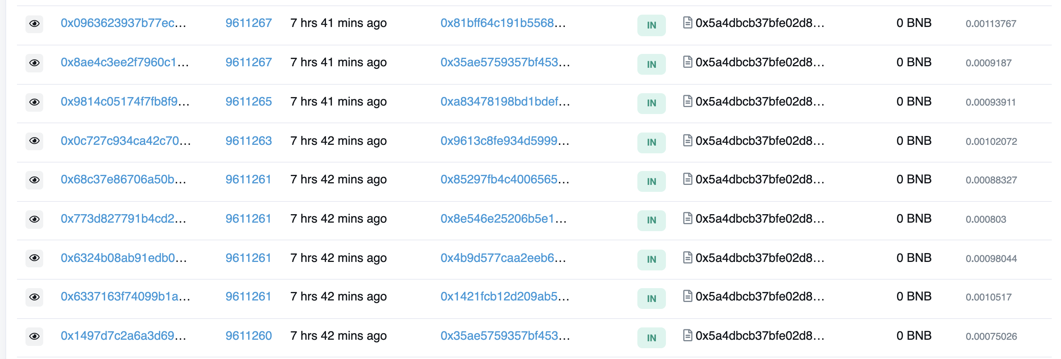
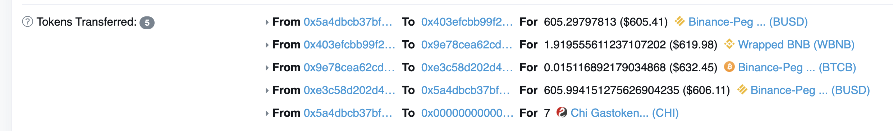
1.1 DEX Arbitrage Bot
The Arbitrage Bot can Find Arbitrage Transactions almost Every minutes

Slide 5
1.2 MEV Bots
Block Body - Without MEV
……
DEX Bot purchase 1000 ETH at Uni
……
……
Block Body - With MEV
……
DEX Bot purchase 1000 ETH at Uni
MEV Bot send arbitrage transaction
Arbitrage Bot1 send arbitrage transaction
Arbitrage Bot2 send arbitrage transaction
……
Nobody can win over the miners!!!

Slide 6
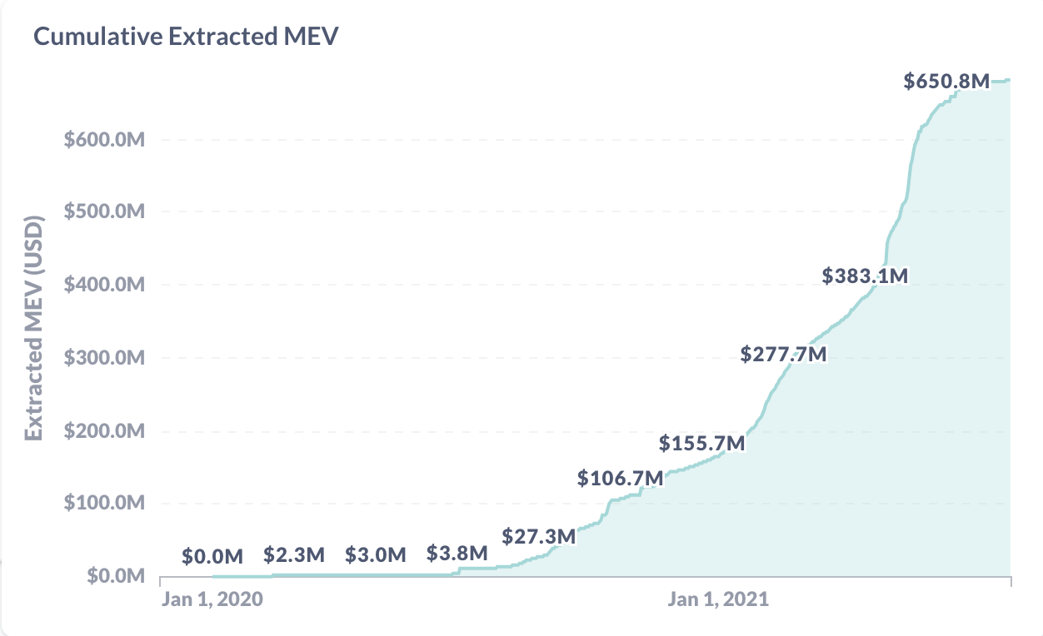
1.2 MEV Bots
The MEV on Ethereum becomes a huge value and a part of it comes from DEX Arbitrage
$677.6M

Slide 7
2 Flash Arbitrage
Block Body - With MEV
……
DEX Bot purchase 1000 ETH at Uni
MEV Bot send arbitrage transaction
Arbitrage Bot1 send arbitrage transaction
Arbitrage Bot2 send arbitrage transaction
……
Block Body - With FlashArbitrage
……
DEX Bot purchase 1000 ETH at Uni Flash Arbitrage
MEV Bot send arbitrage transaction
Arbitrage Bot1 send arbitrage transaction
Arbitrage Bot2 send arbitrage transaction
……

Slide 8
2 Flash Arbitrage
AcySwap V.S. Other Swap
User
Start
User
Start
Start
Bot
Swap
Swap
Arbitrage
Arbitrage
End
End
End

Slide 9
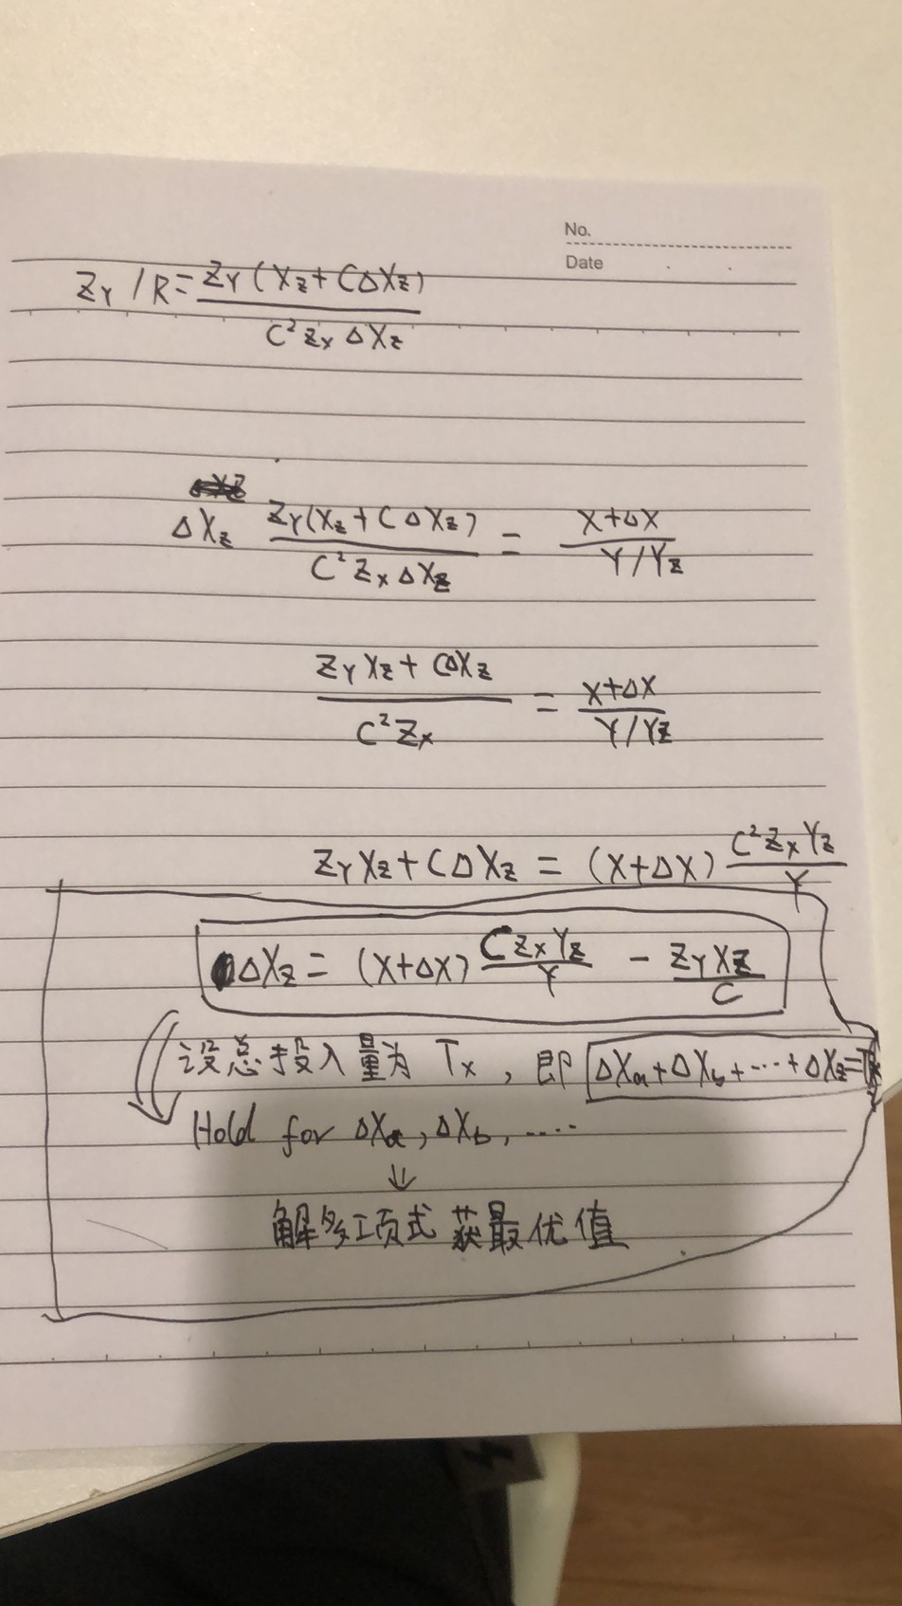
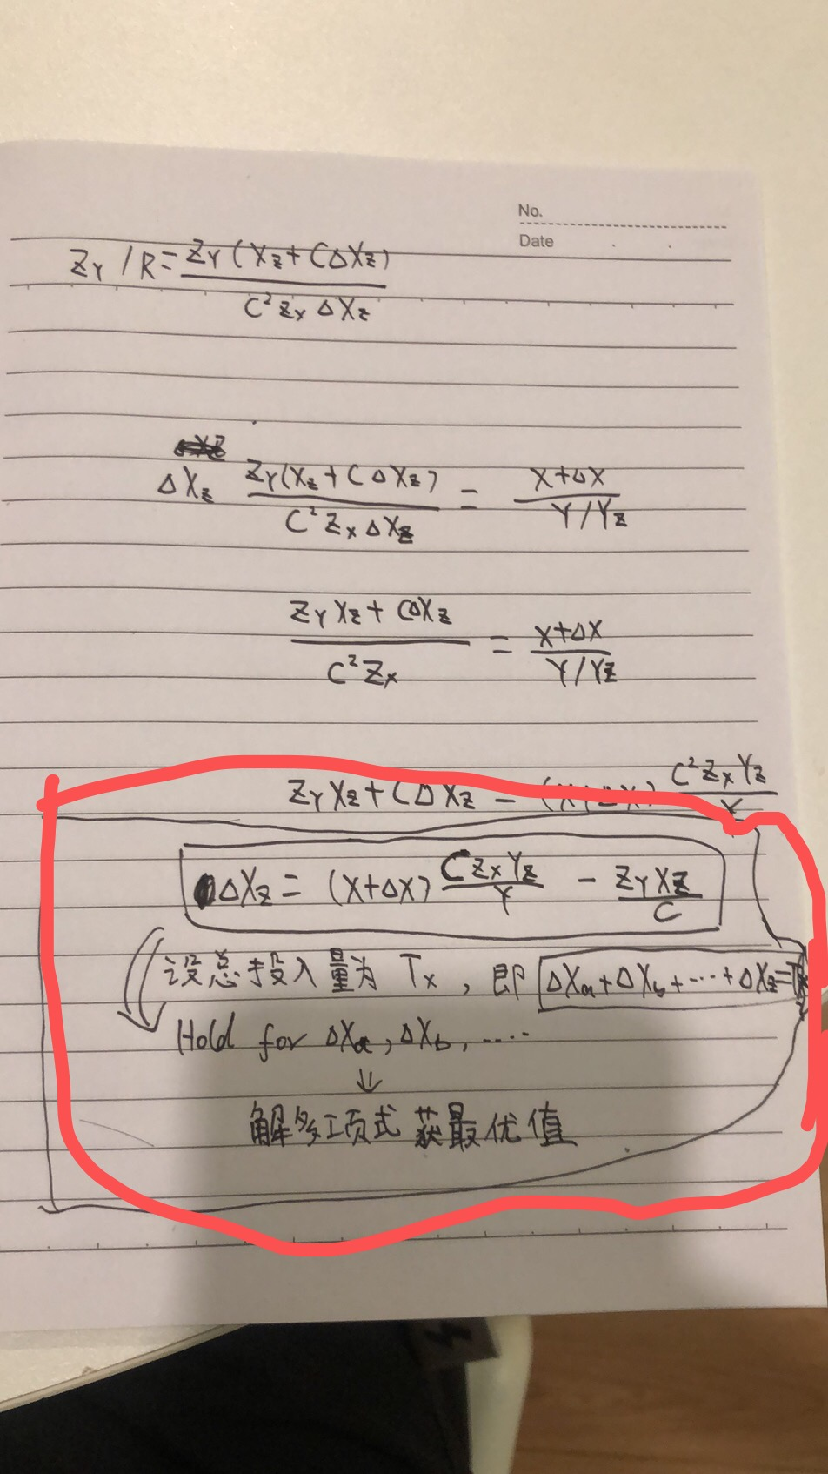
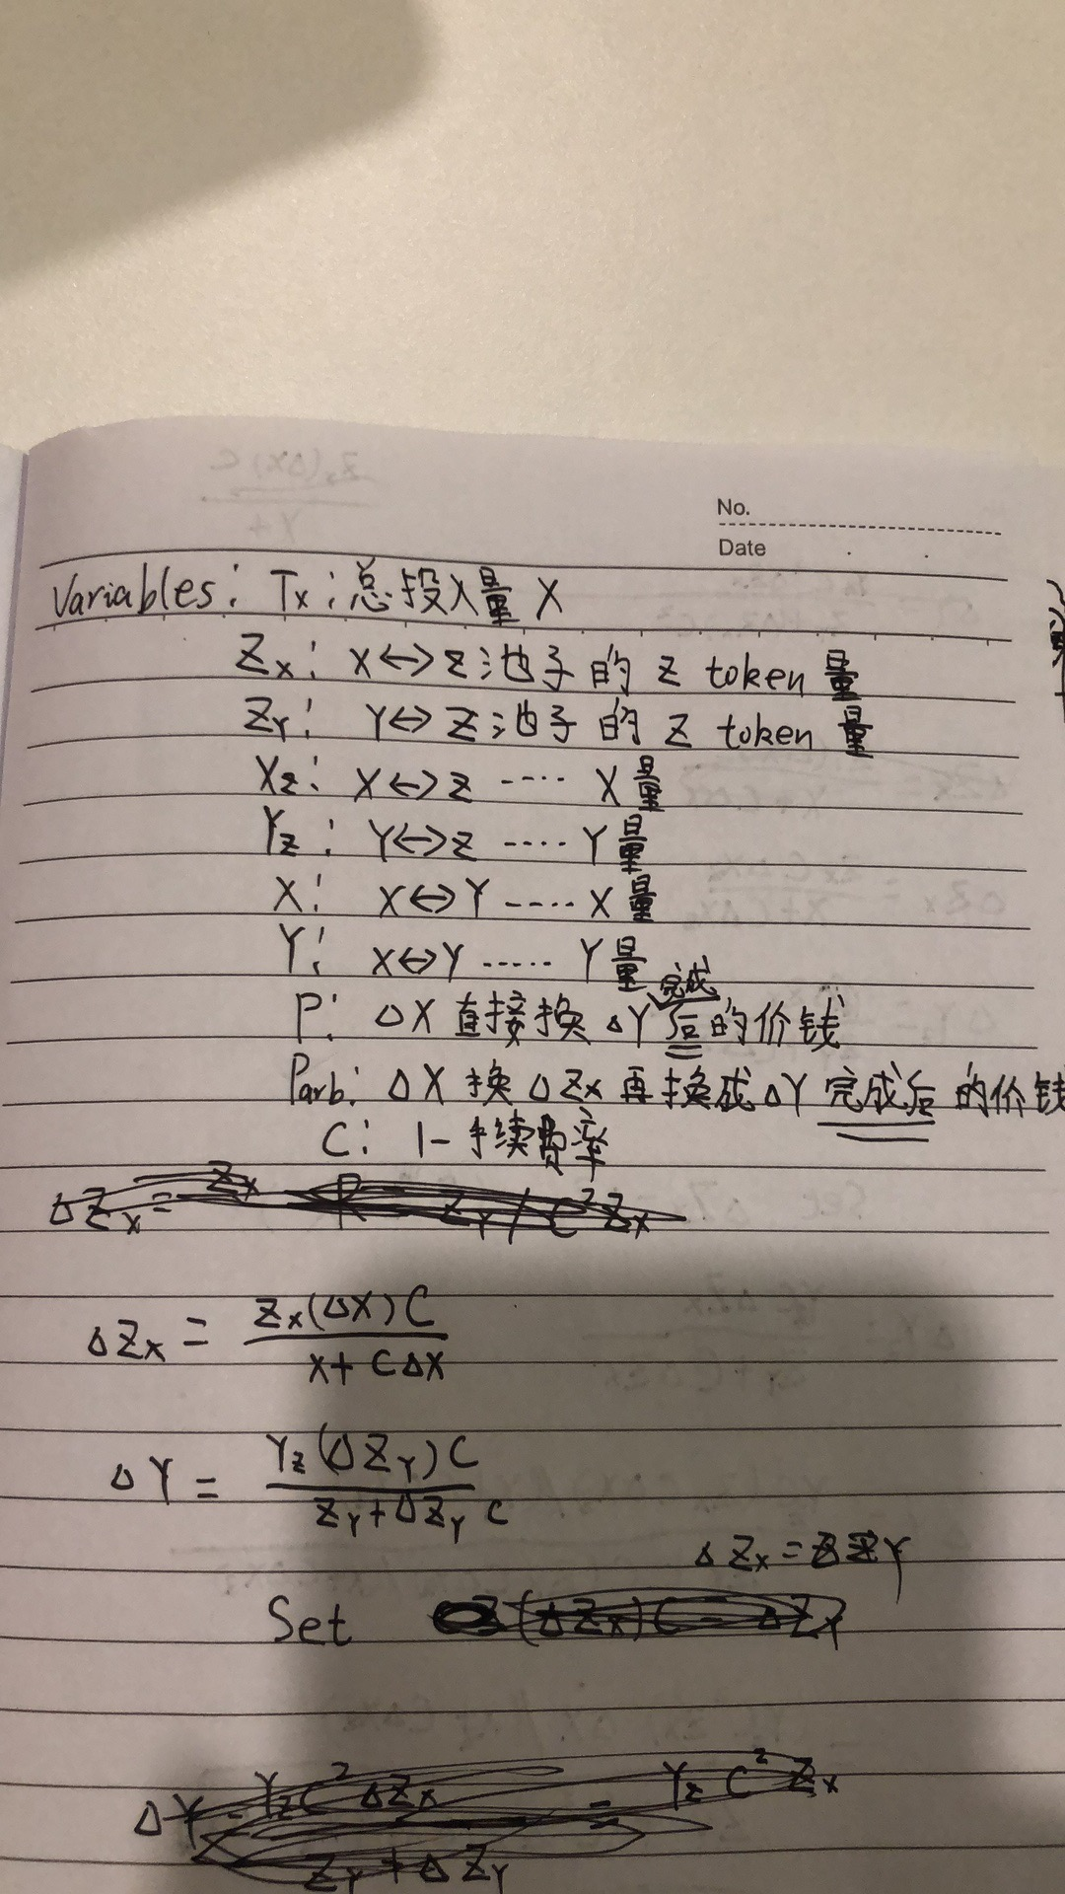
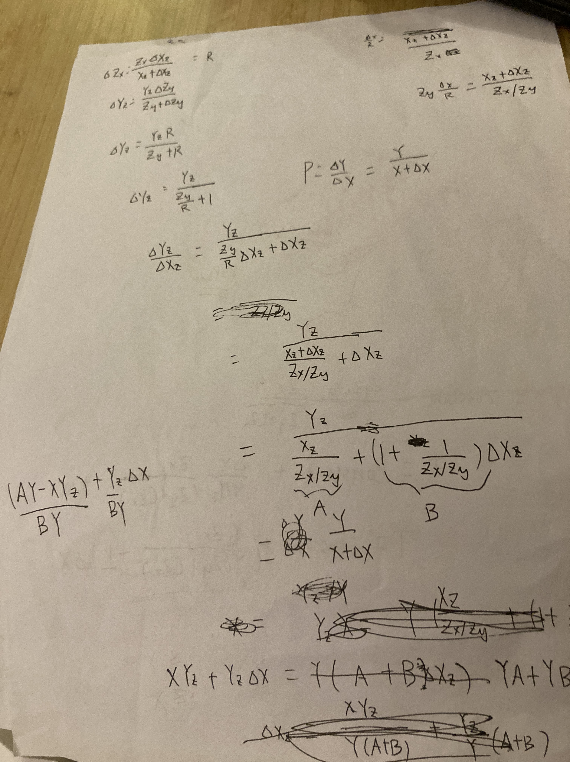
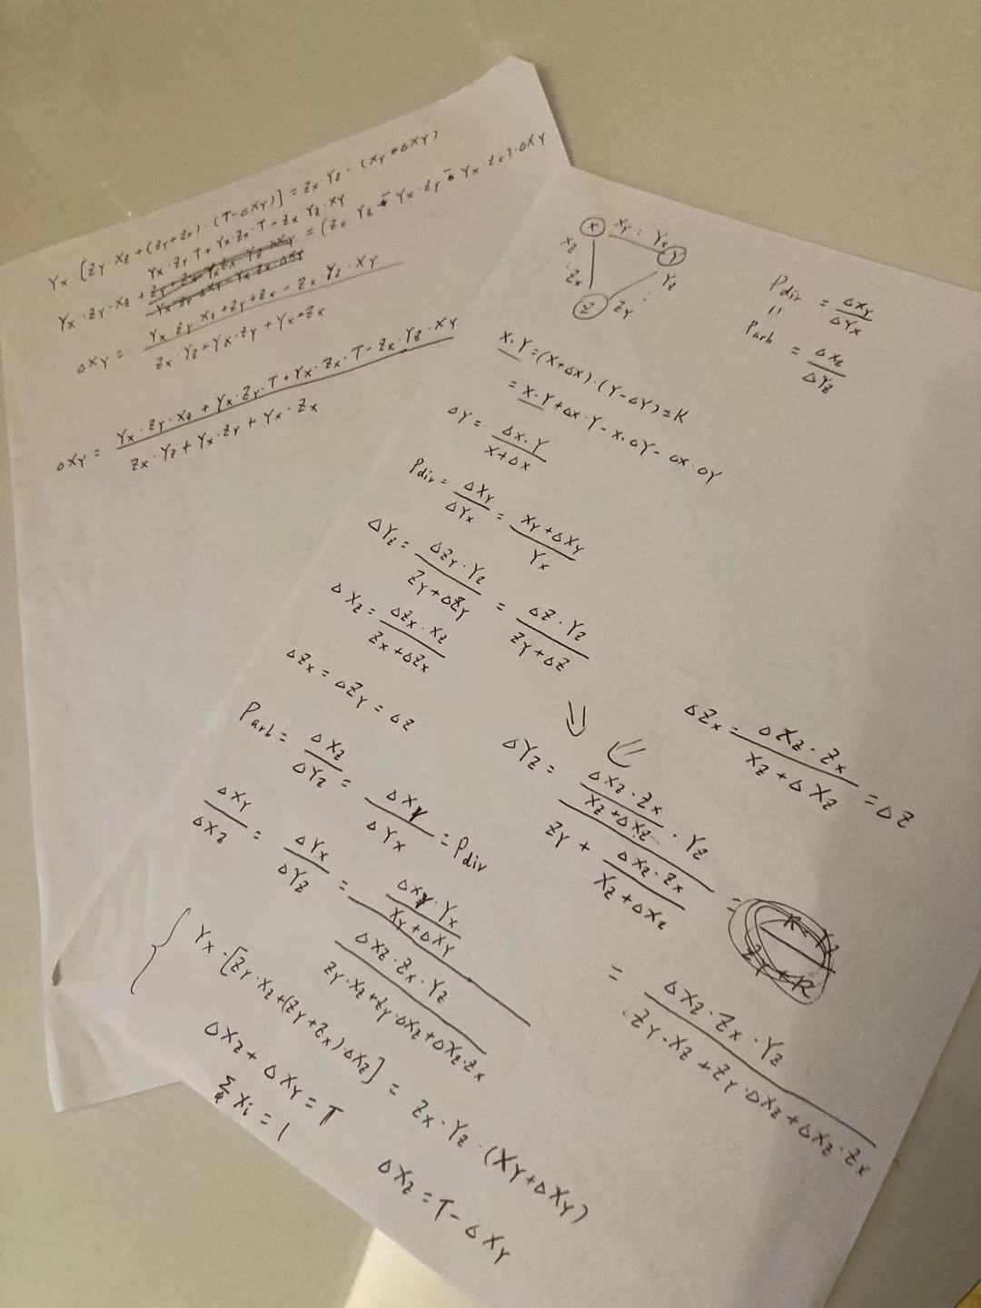
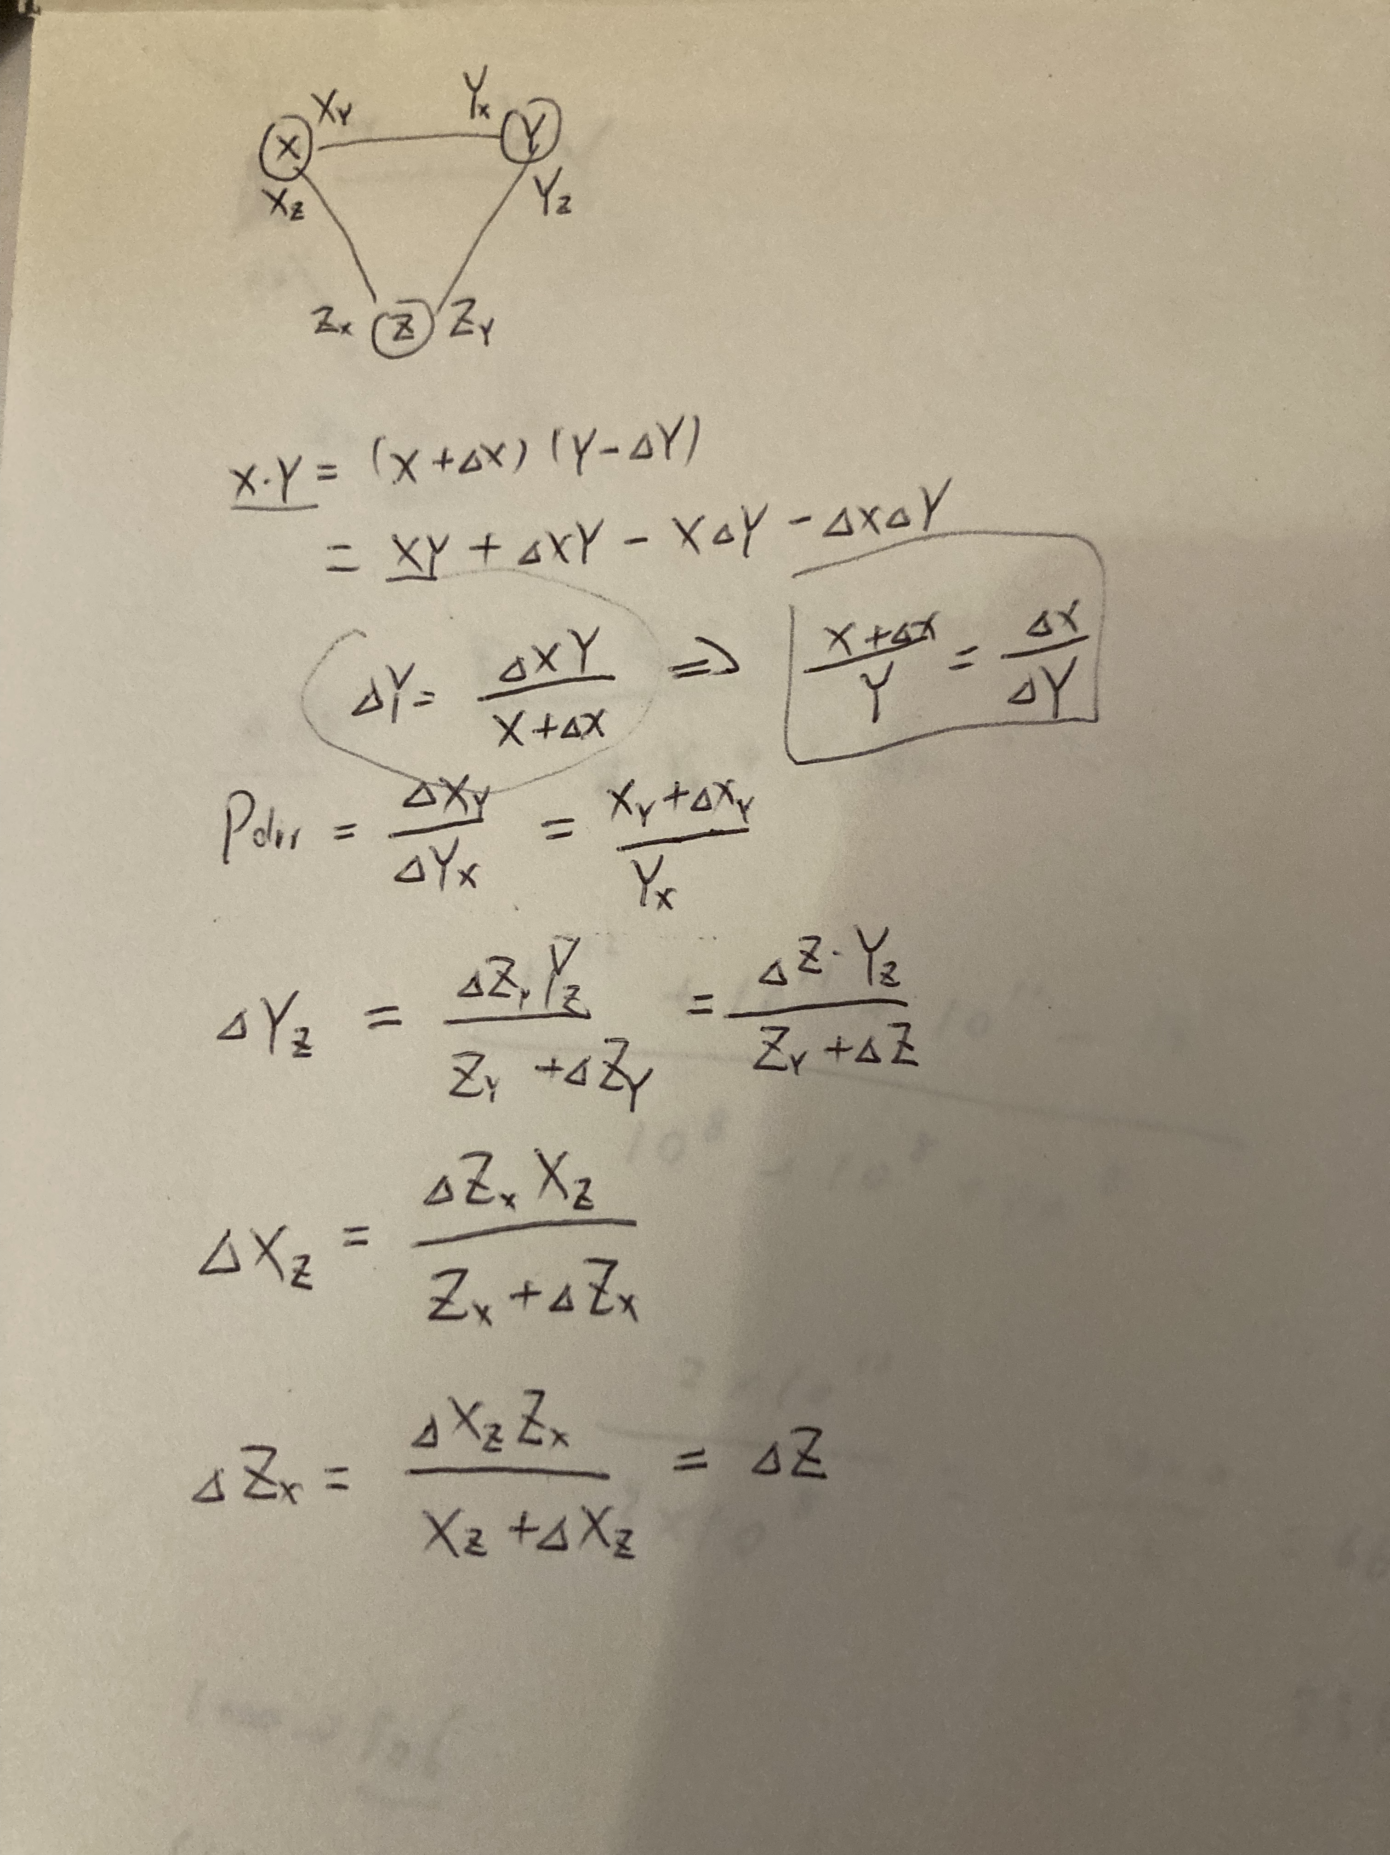
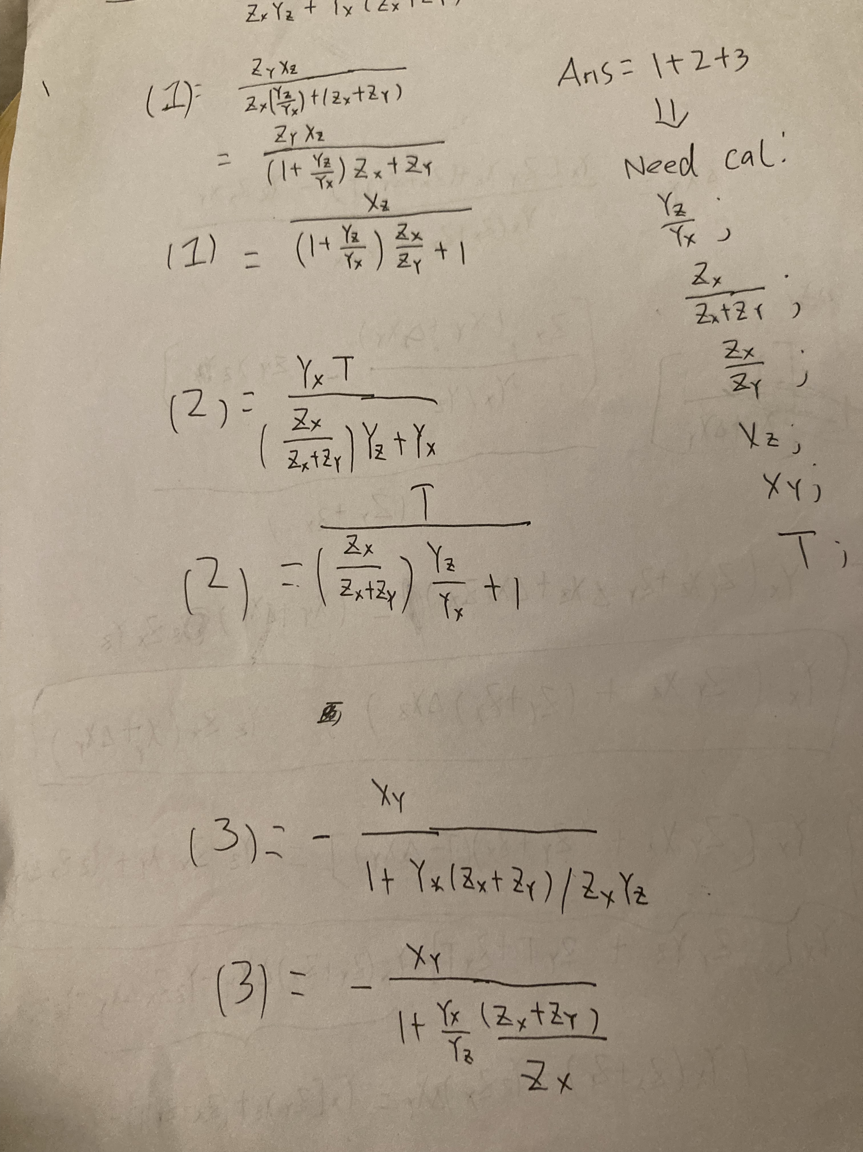
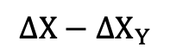
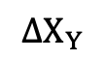
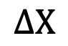
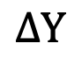
3 Our Experiment
With Token X, Y, and Z, there are 3 pairs (X, Y), (Y, Z), and (Z, X)
$$∆X$$
$$∆X_{Y}$$
$$∆Y$$
max
X
Xy
Yx
Y
$$∆X−∆X_{Y}$$
Xz
Yz
Zx
Zy
Z

Slide 10
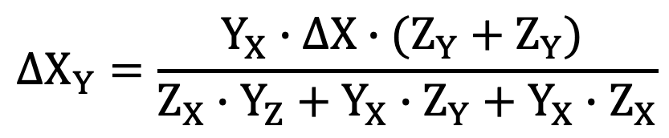
3 Our Experiment
With Token X, Y, and Z, there are 3 pairs (X, Y), (Y, Z), and (Z, X)
$$∆X$$
$$∆X_{Y}$$
$$∆Y$$
max
X
Xy
Yx
Y
$$∆X−∆X_{Y}$$
Xz
Yz
$$∆X_{Y}=\frac{Y_{X}∙∆X∙(Z_{Y}+Z_{Y}) }{Z_{X}∙Y_{Z}+Y_{X}∙Z_{Y}+Y_{X}∙Z_{X}}$$
Zx
Zy
Z

Slide 11
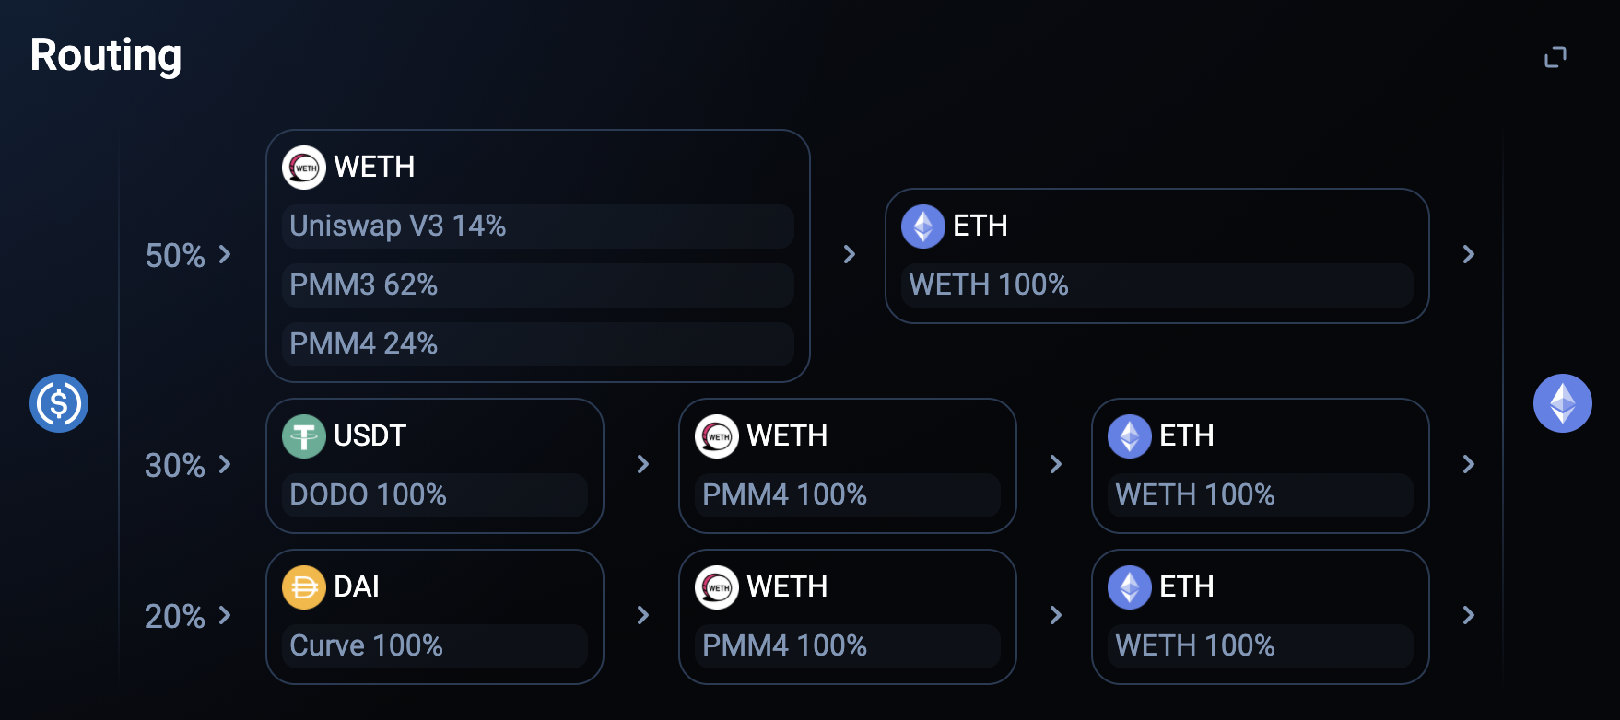
4 Why not 1inch?
The control of Transaction

Slide 12
10 Chainlink Price
Chainlink
More Information from Other Exchange
AMM Price
Limit AMM Price in a Secure Range
Arbitrage
Auto Arbitrage For Price Generation

Slide 13
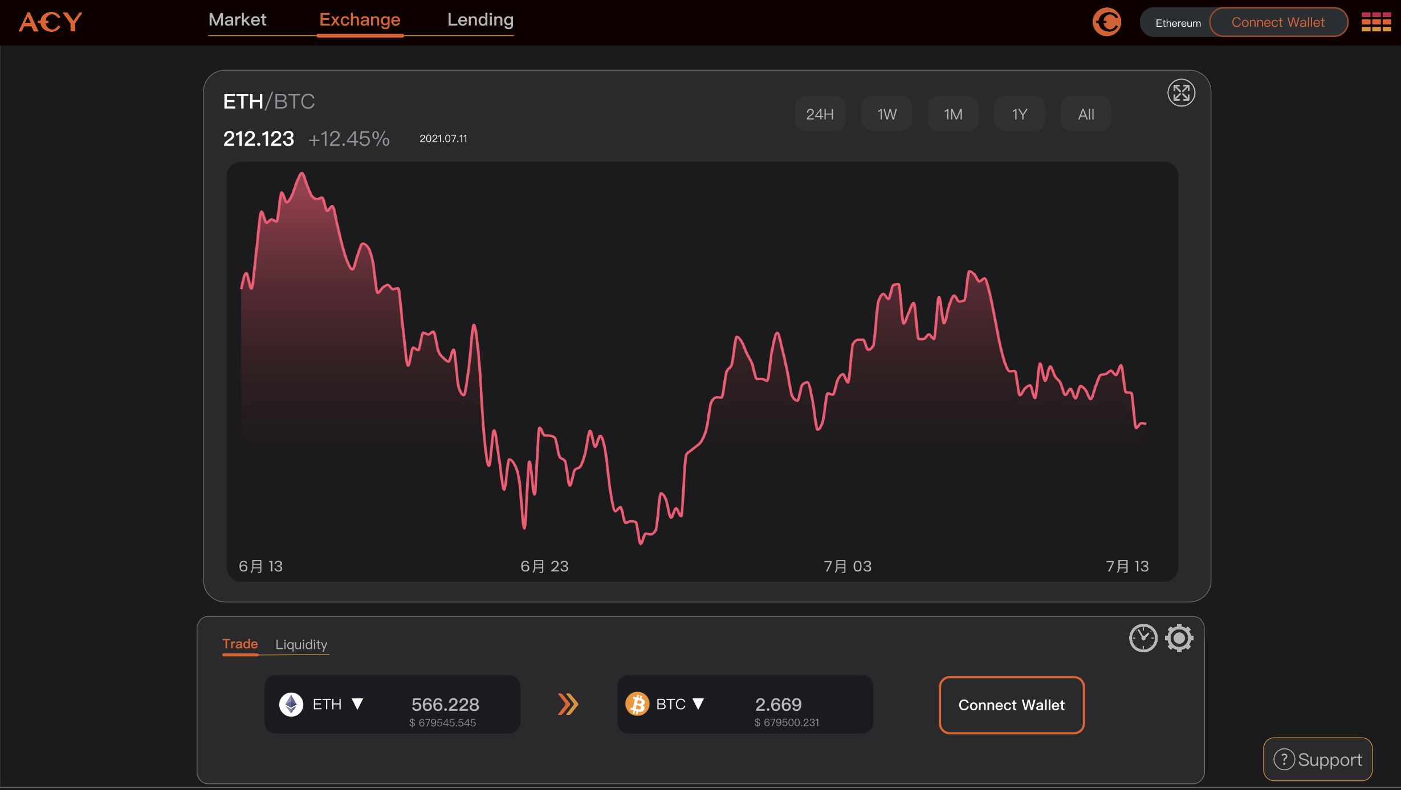
11 Our Demo

Slide 14
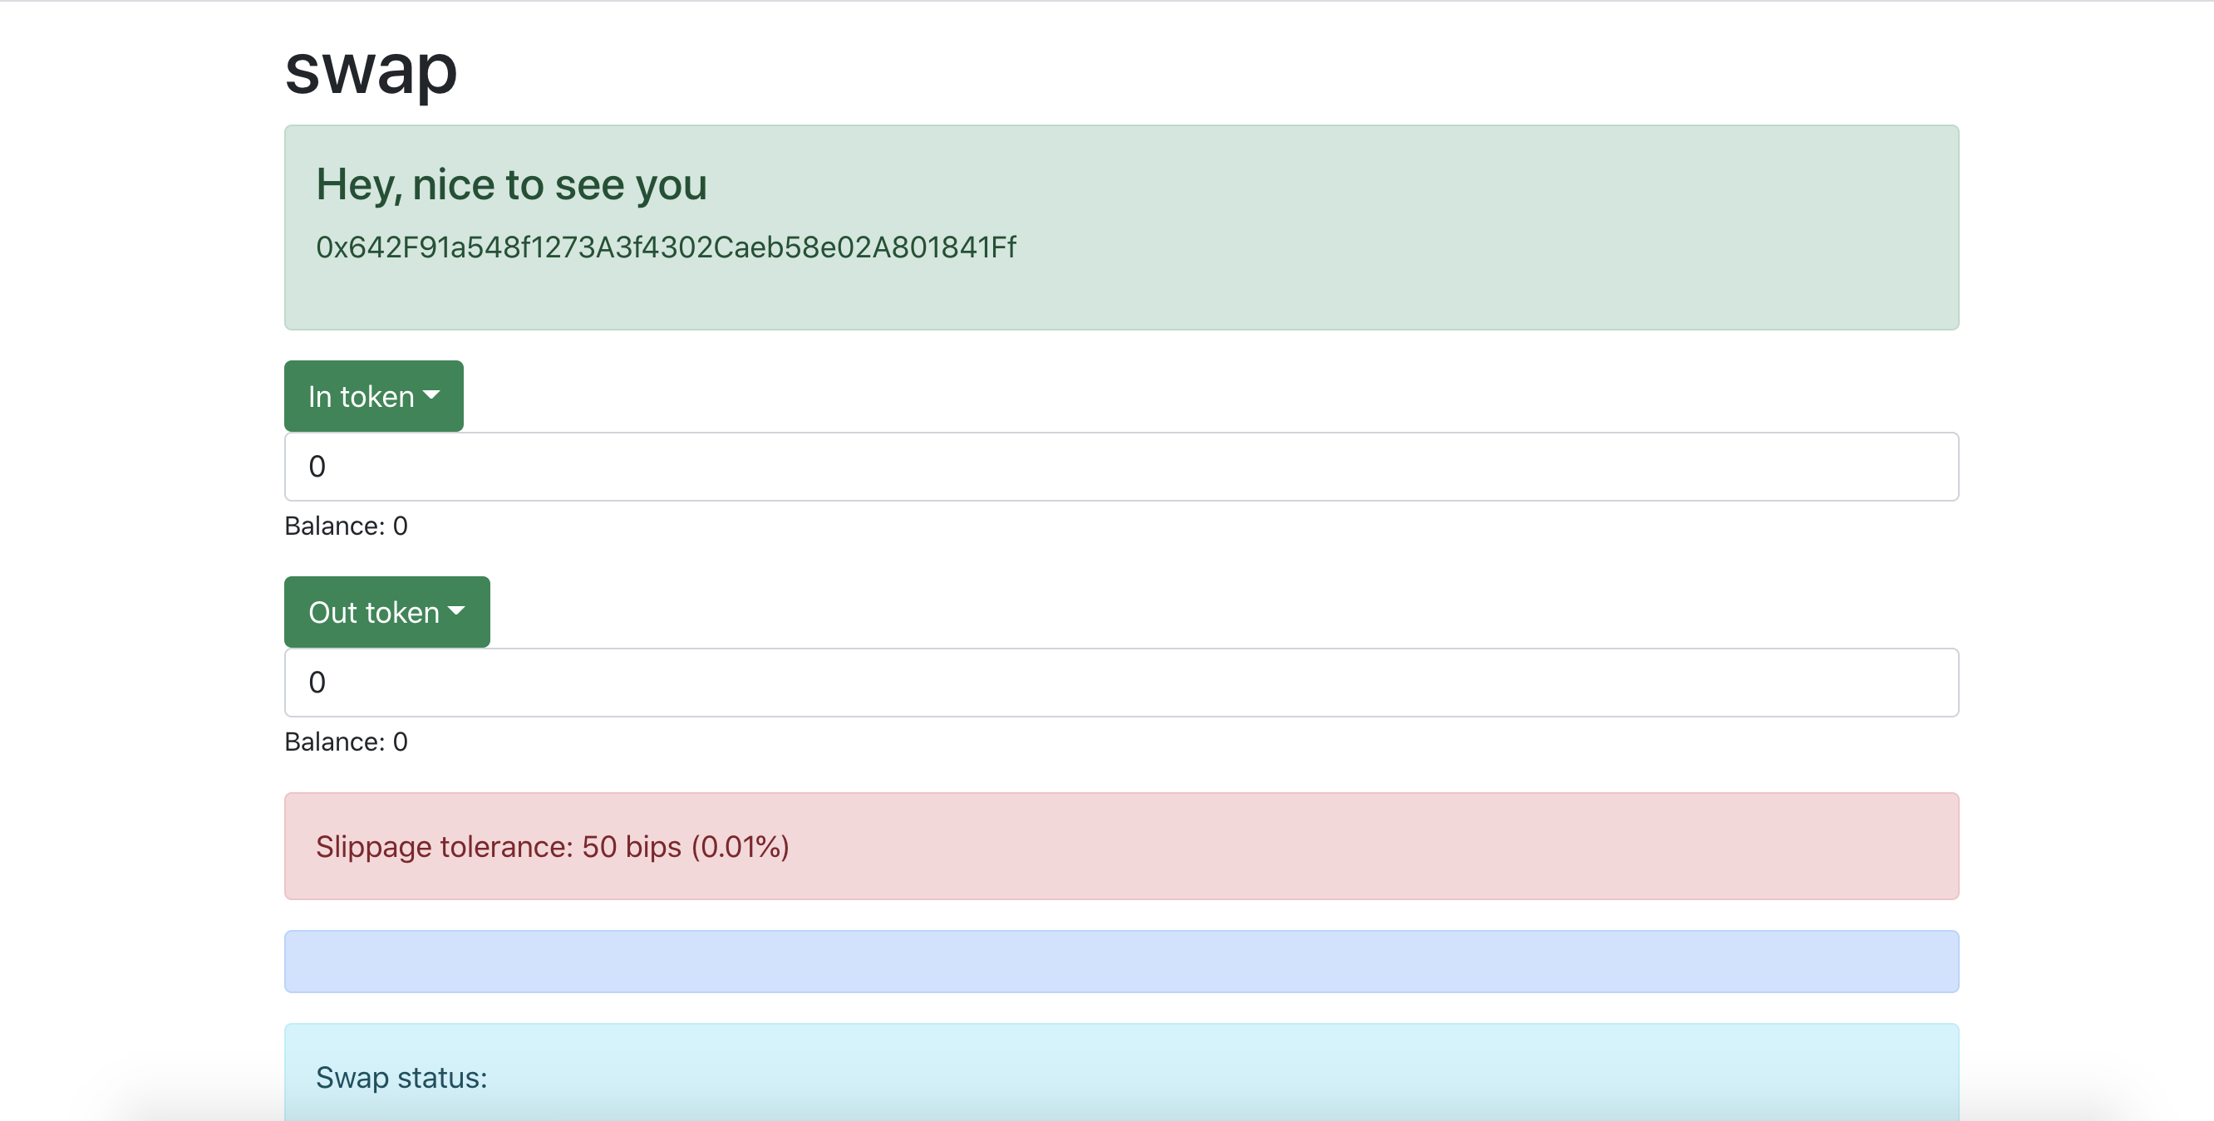
11 Our Demo

Slide 15


You can find us on Twitter & Medium @ACY Finance

